Slide 1
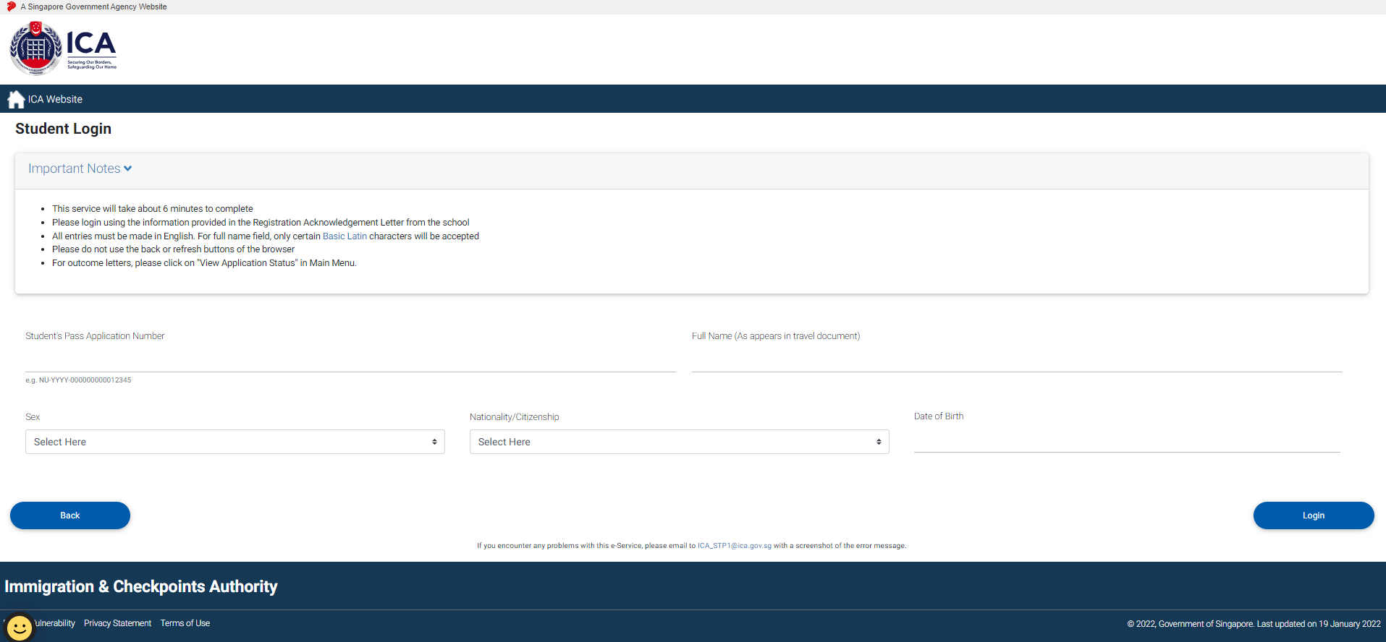
Foreign Student Login Page
Go to: https://eservices.ica.gov.sg/solar/index.xhtml
Select “Foreign Student” icon
Login with Student’s particulars provided in Registration Acknowledgement.

Slide 2
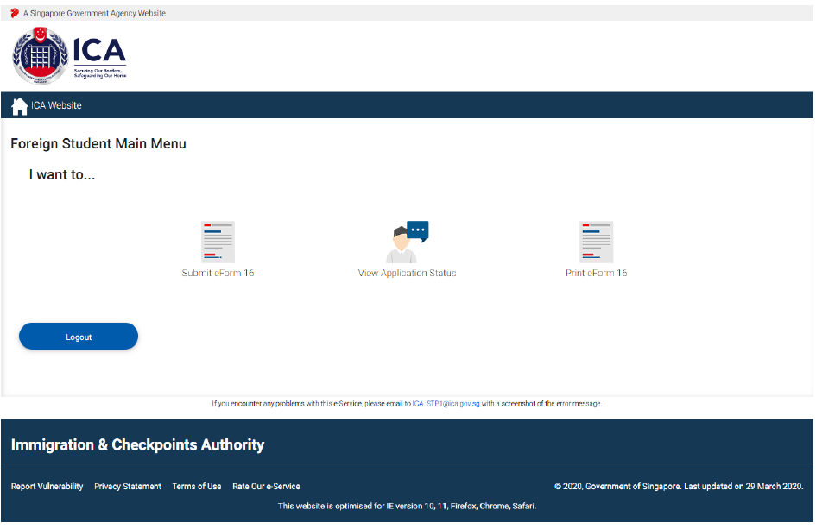
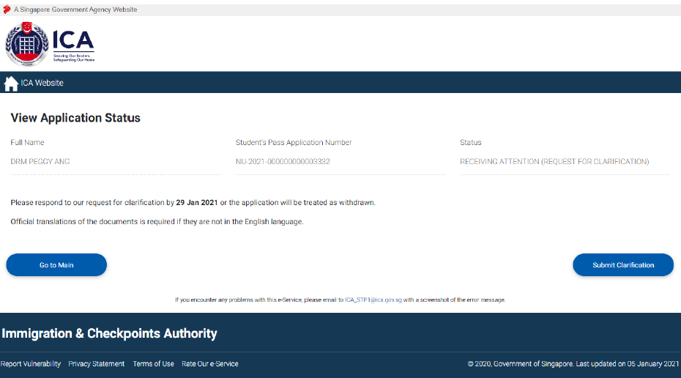
Foreign Student Main Menu Page
Select “View Application Status” to enquire on the current status of the Student’s Pass Application.
View Application Status – Receiving Attention
For “Receiving Attention (Request for Clarification)” status, click [Submit Clarification] to answer clarification questions and/or upload clarification documents.

Slide 3
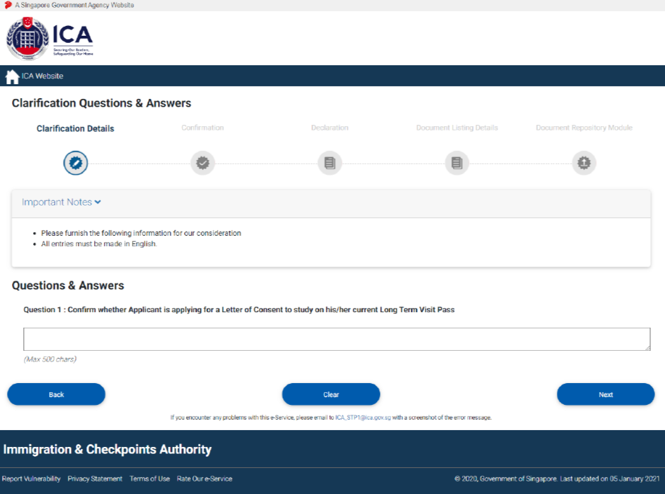
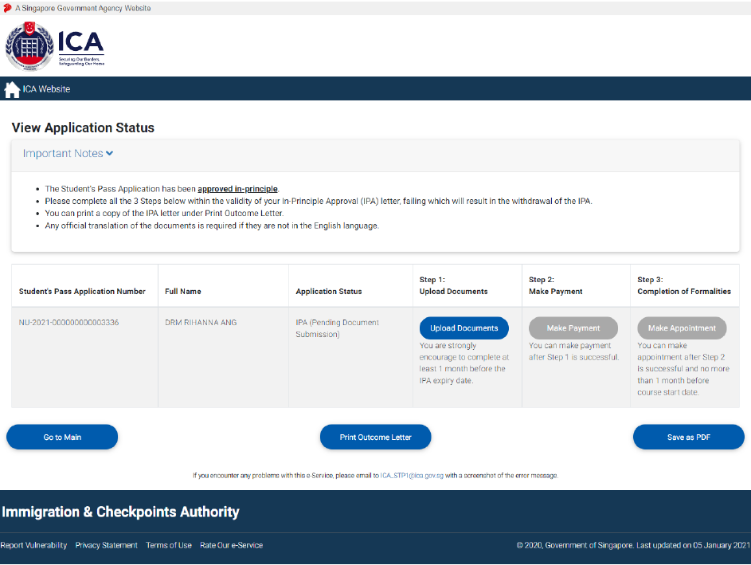
Clarification Questions & Answers
Answer all clarification questions and click [Next] to confirm and agree on the declaration.
View Application Status – IPA (Pending Document Submission)
For “IPA (Pending Document Submission)” status, click [Upload Documents] to view the document listing details which applicant is required to upload for COF.

Slide 4
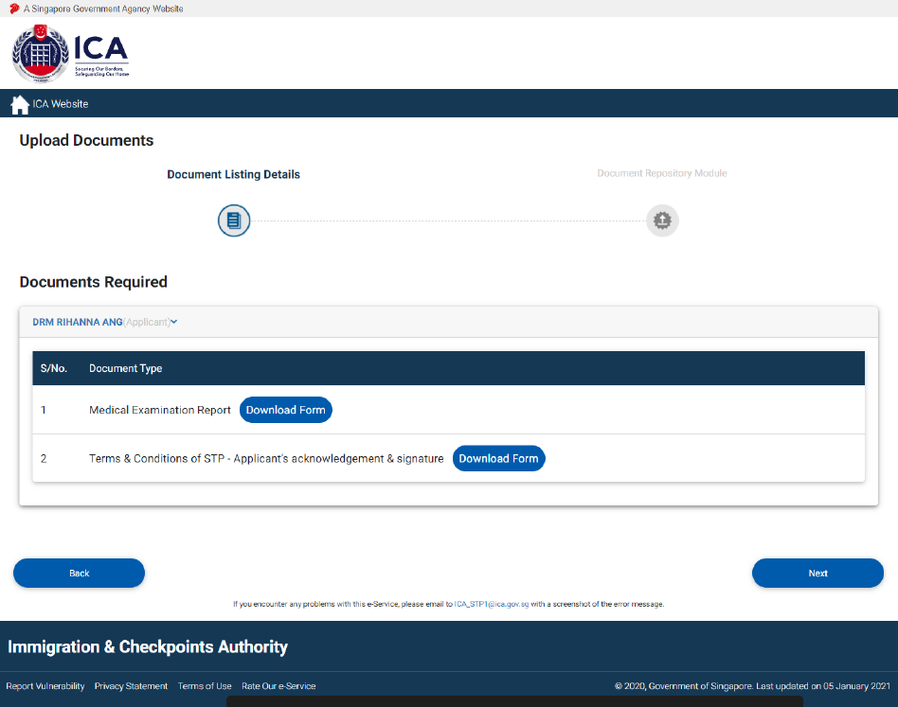
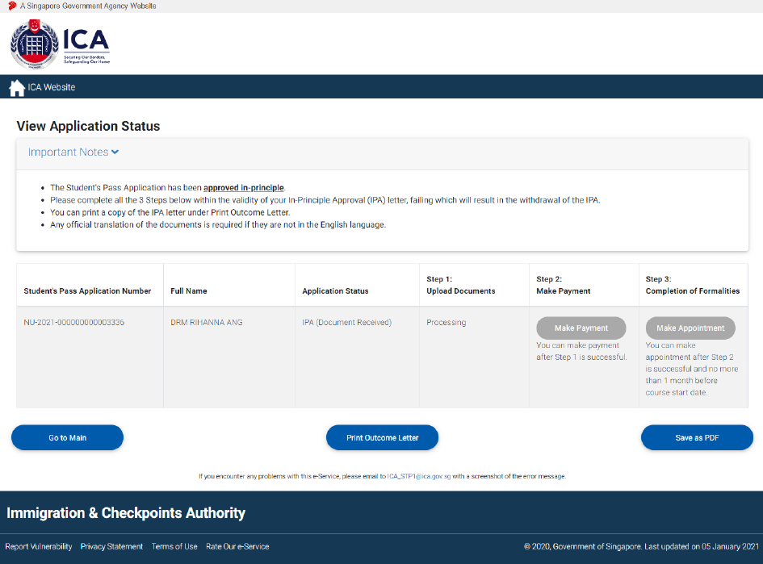
Upload Documents
Click [Download Form] to download respective document templates and click [Next] to redirect to DRM page for uploading of documents.
After Upload of Documents
After uploading of COF documents online, the status is updated to “IPA (Document Received)”.

Slide 5
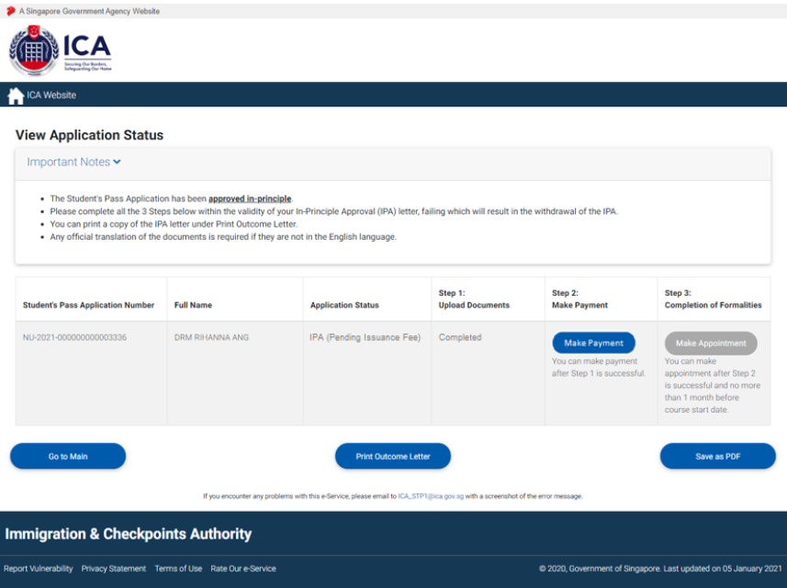
View Application Status – IPA
(Pending Clarification)
For “IPA (Pending Clarification)” status, click [Upload Documents] to answer clarification questions and/or upload clarification documents.
View Application Status – IPA (Pending Issuance Fee)
For “IPA (Pending Issuance Fee)” status, click [Make Payment] to proceed with payment.

Slide 6
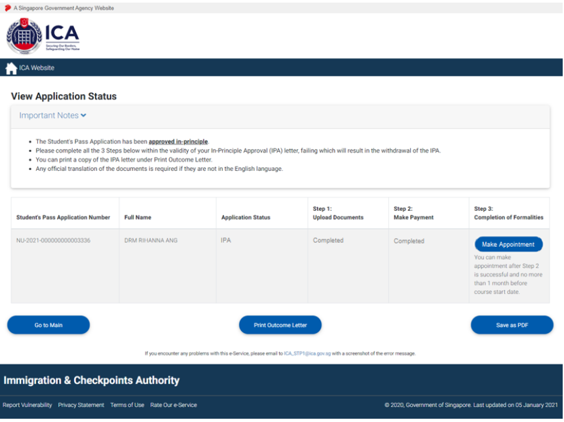
View Application Status – Make e-Appointment
For “IPA” status, click [Make Appointment] to redirect to e-Appointment page.

Slide 7
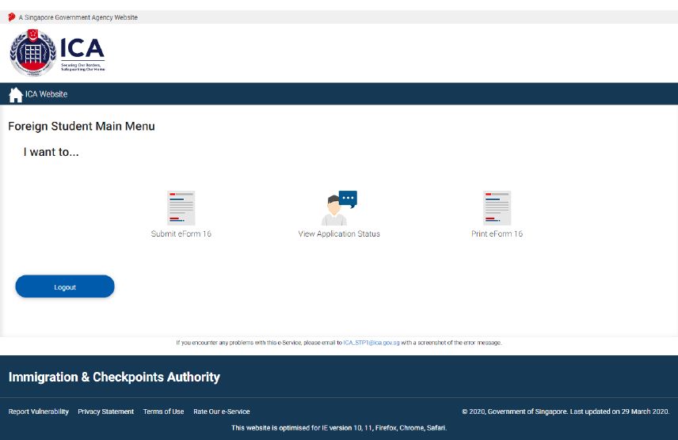
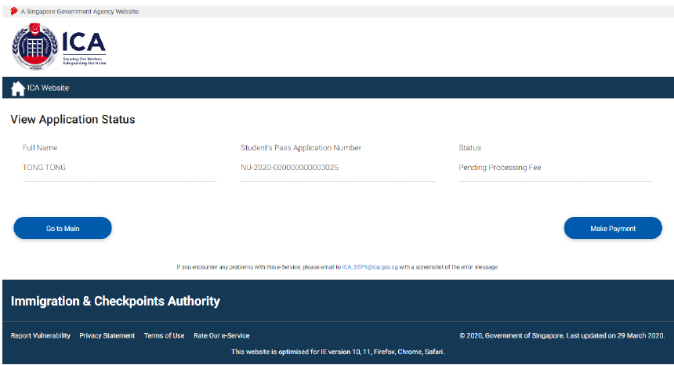
Make Payment
Non-scholar is required to make processing and issuance fee payment for Student’s Pass.
Select “View Application Status” to enquire on the current status of the Student’s Pass Application.
Click on [Make Payment] to be redirected to payment selection page. There will be three types of payment mode available as shown in the next slide.

Slide 8
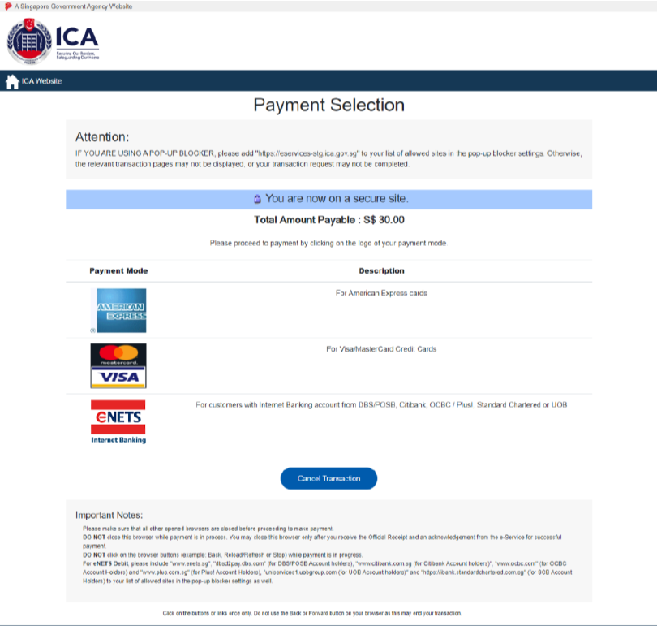
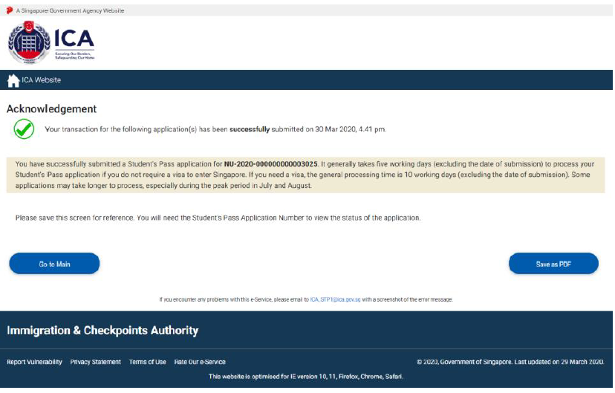
Payment Selection
Enter card details and OTP to proceed with payment. After successful payment has been made, system will redirect to Acknowledgement page.

Slide 9
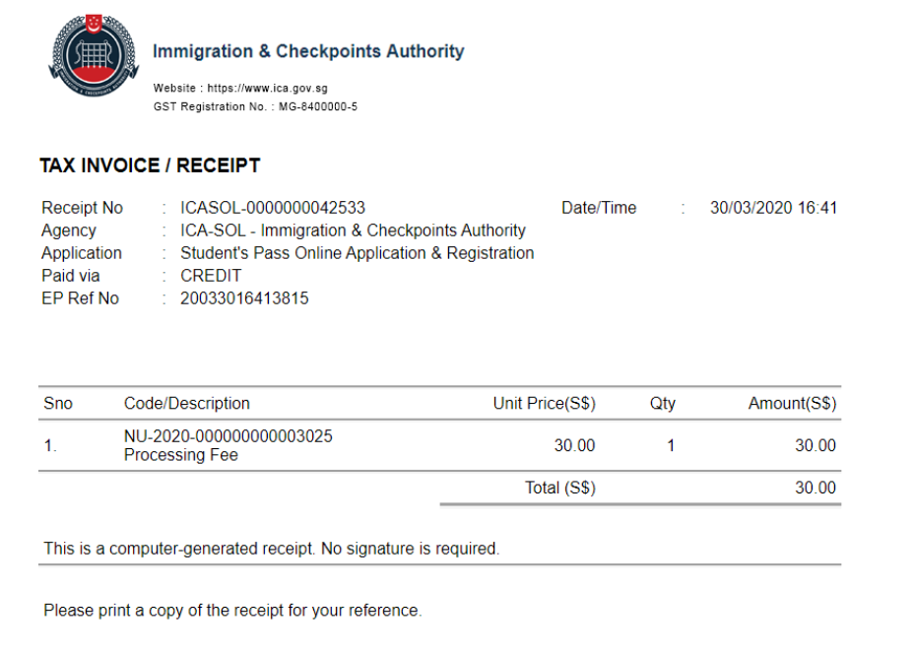
Receipt
A one-time generation of receipt is displayed as shown. Take note to disable pop-up blocker in order to view the receipt.

Slide 10
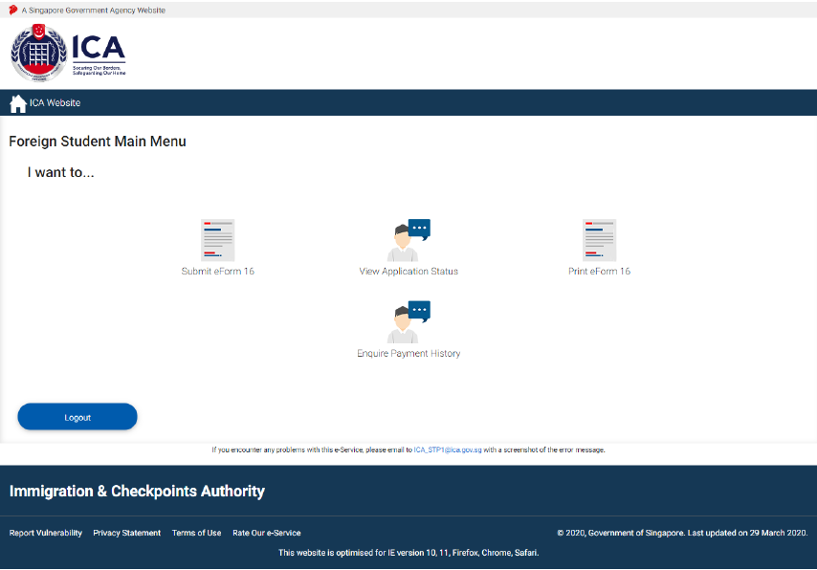
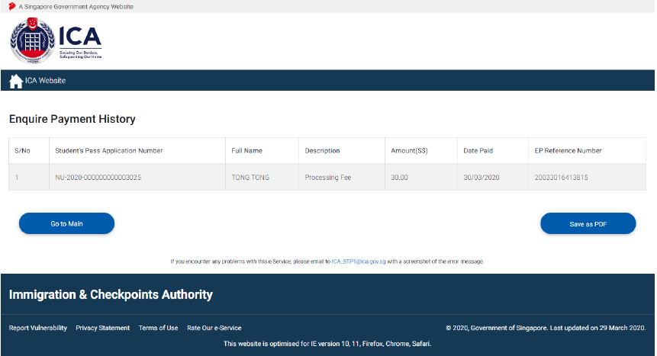
Enquire Payment History
Select “Enquire Payment History” icon to view payment history of Student’s Pass Application.
Click on [Save as PDF] to save or print the payment history details.

Slide 11
Print Outcome Letter
Select “View Application Status” icon to enquire on the outcome status of the Student’s Pass Application. .

Slide 12
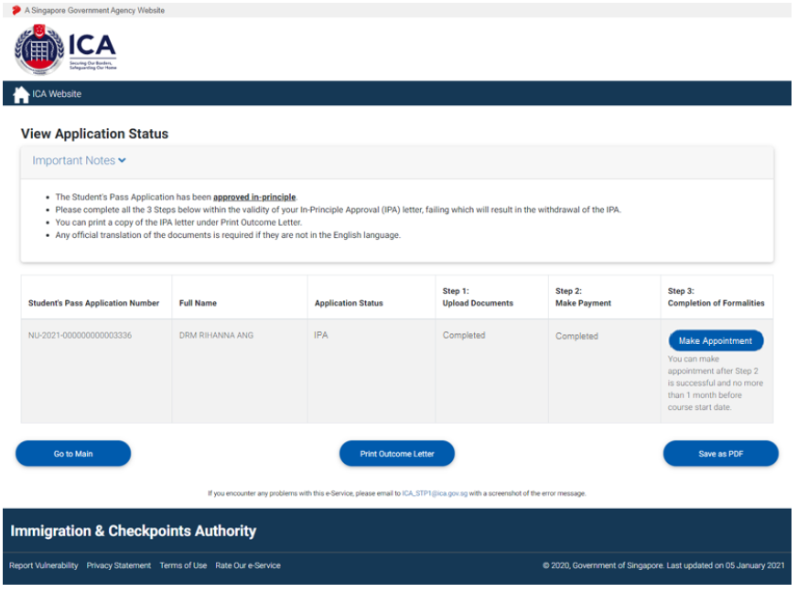
View Application Status - Print Outcome Letter
Click on [Print Outcome Letter] to view or print the outcome letter.
Click on [Make Appointment] to make an appointment.
Click on [Save as PDF] to save or print the application status page

