Slide 1
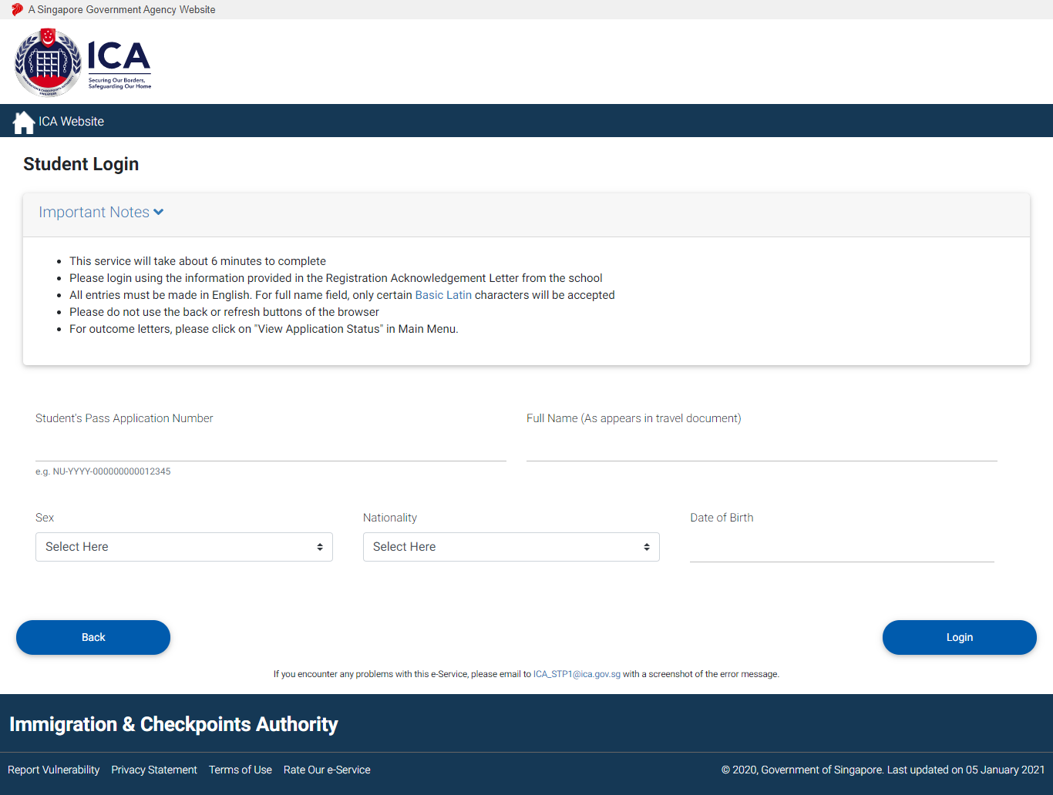
Student Login Page
Go to https://eservices.ica.gov.sg/solar/index.xhtml
Clicking on “Foreign Student” icon will re-direct to Student login page (this slide).
Login with Student’s particulars stated in Registration Acknowledgement to access Student main menu.

Slide 2
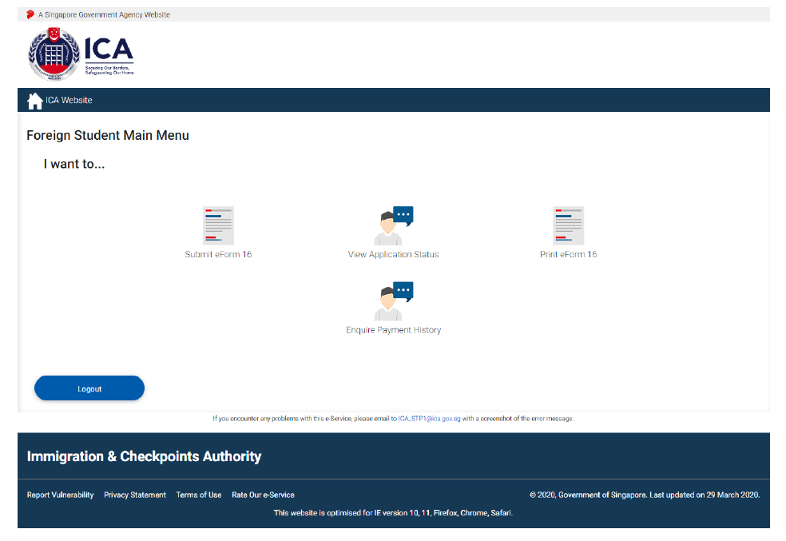
Student Main Menu Page
Select “Submit eForm 16” icon.
Before eForm 16 submission, applicant has the following functions available:
• Submit eForm 16
• Print eForm 16
• View Application Status
After making processing fee payment, applicant has an additional function available:
• Enquire Payment History
After receiving outcome status email notification, applicant can proceed to make issuance fee payment and has an additional function available:
• Print Outcome Letter
For Student’s Pass Application with status “Approved (LOC)”, applicant can print outcome letter without issuance fee payment.

Slide 3
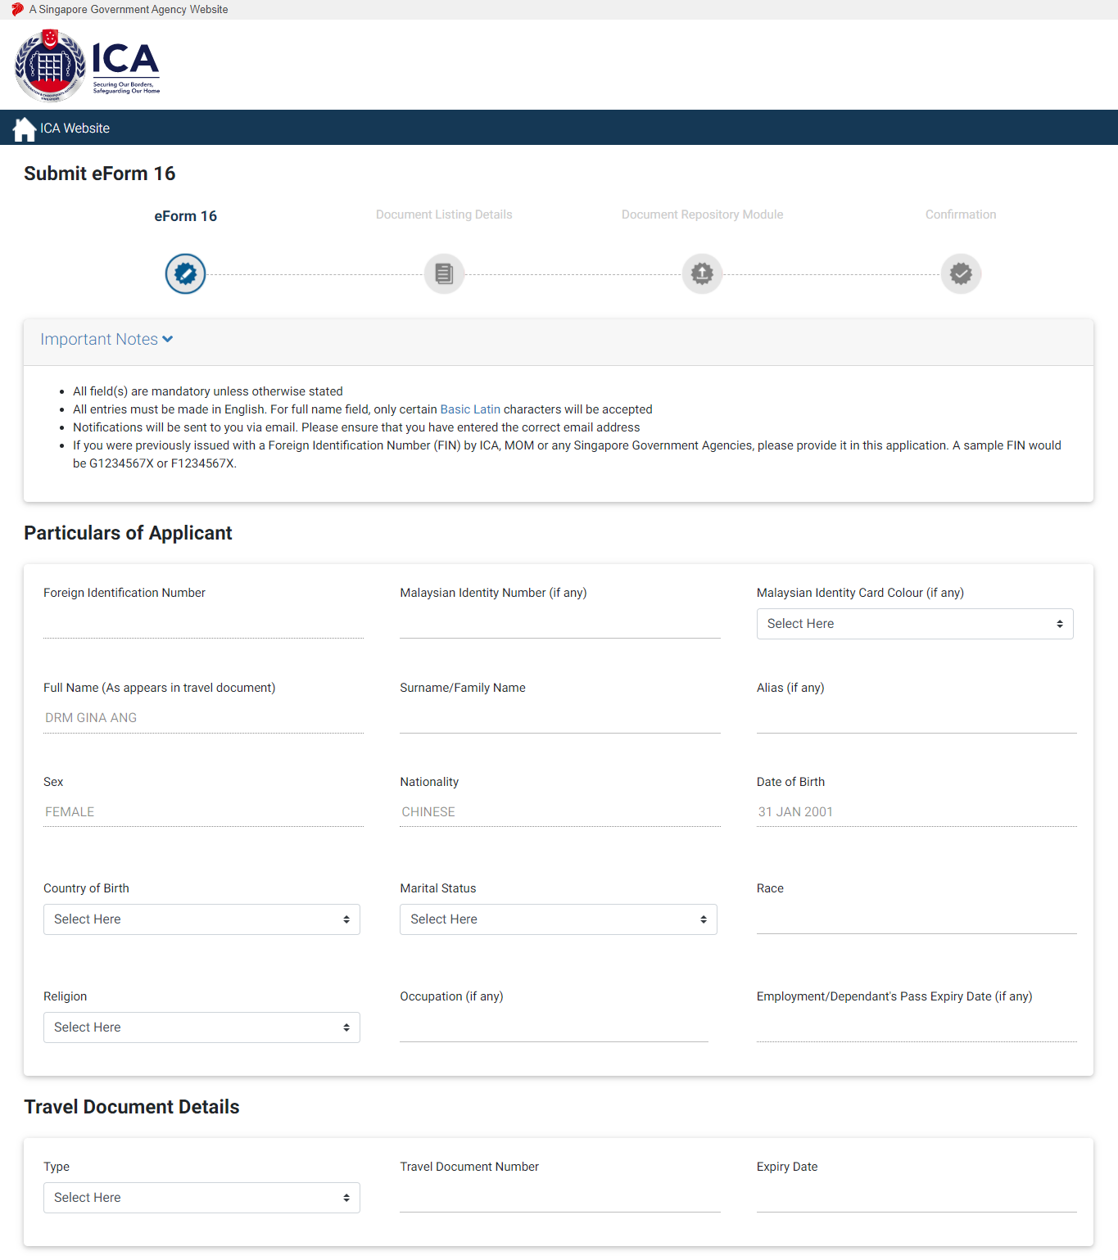
eForm 16 Page Part 1
Enter all mandatory fields under “Particulars of Applicant”, “Travel Document Details”, “Contact Information” and “Course Information” sections.

Slide 4
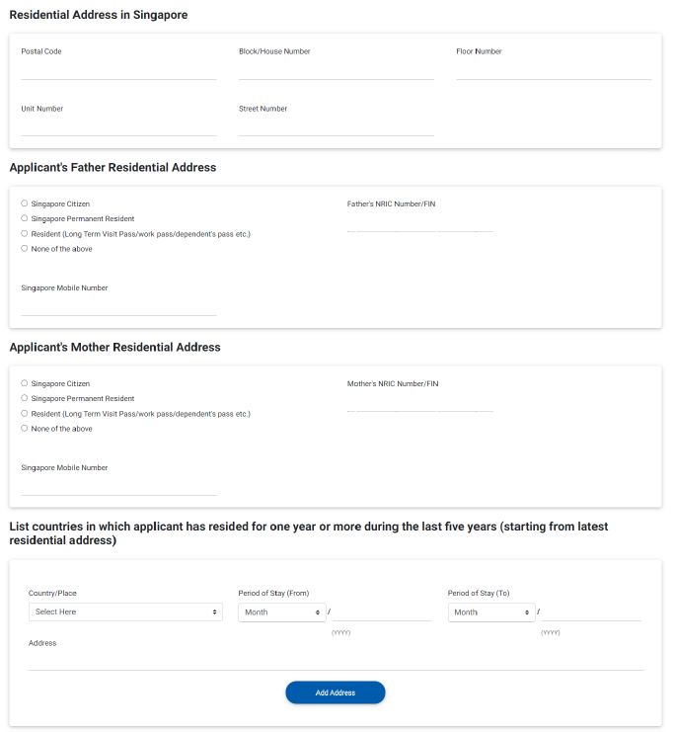
eForm 16 Page Part 2
Enter all mandatory fields under “Residential Address in Singapore” to “List of countries in which applicant has resided for one year or more…”.

Slide 5
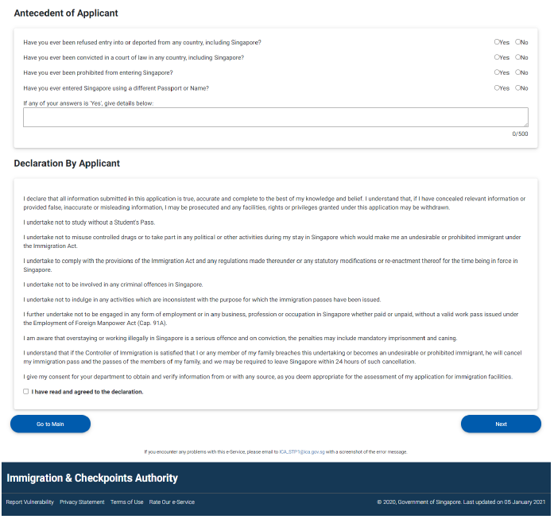
eForm 16 Page Part 3
Enter all mandatory fields for “Antecedent of Applicant” and Agree on the application. Click [Next] to view the document listing details on which documents are required to be uploaded.

Slide 6
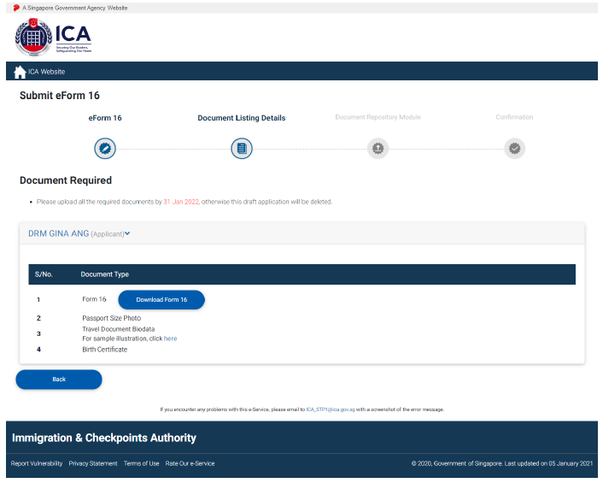
eForm 16 Page Part 4
Click [Download Form 16] to download the eForm 16 in pdf format and click [Next] to redirect to Document Repository Module (DRM) page.

Slide 7
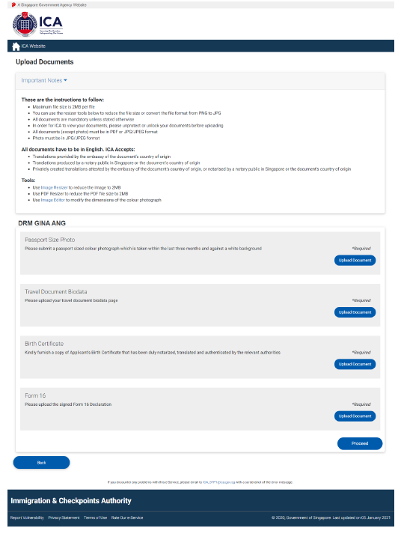
Document Repository Module (DRM) Page
Click respective [Upload Document] to upload documents and click [Proceed] to confirmation page.

Slide 8
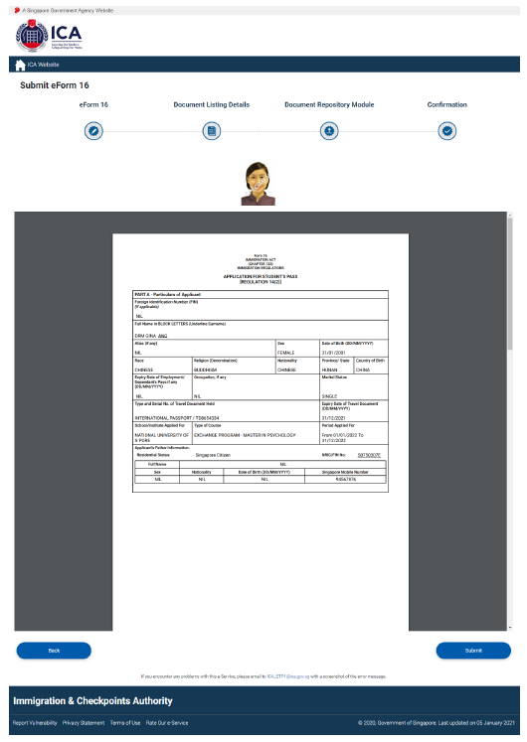
Completing eForm 16 Submission
After confirmation on the details, click [Submit] to complete eForm submission and redirects to summary page.

Slide 9
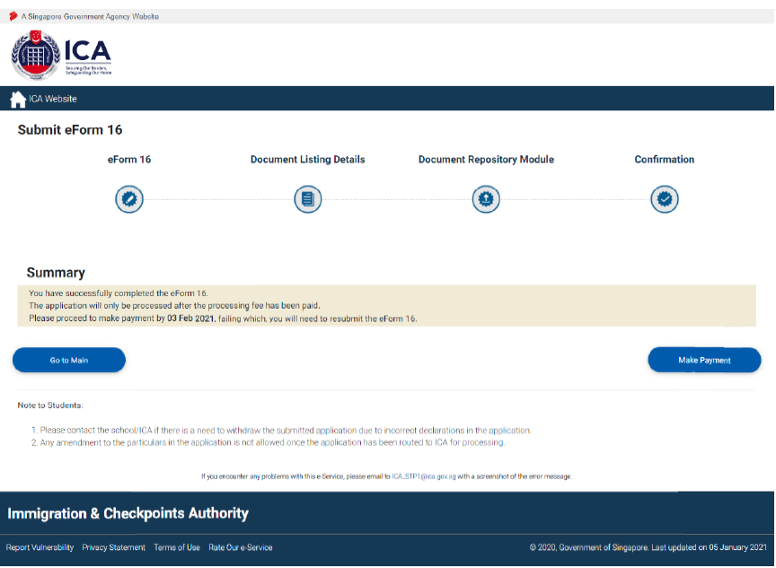
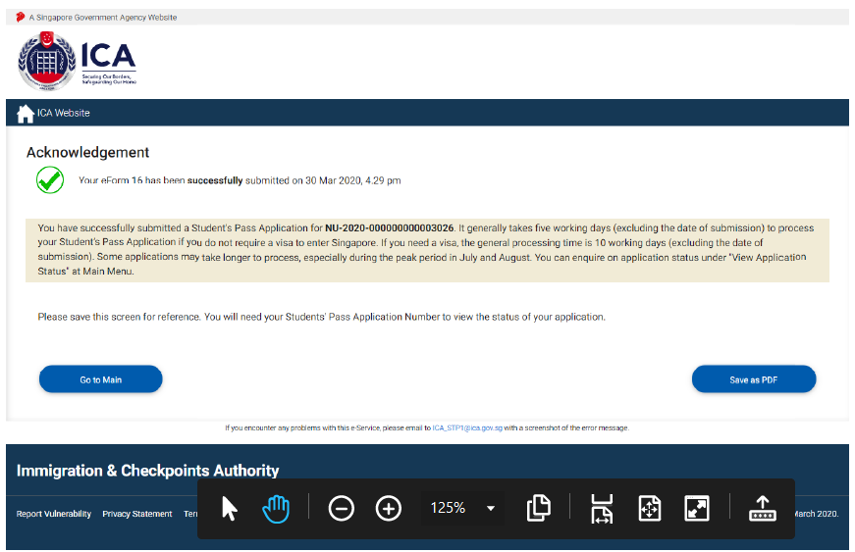
Summary, making Payment, and Acknowledgement
For non-scholar application, processing fee is required. Click on [Make Payment] to proceed with processing fee payment.
For scholar application, payment is not required. Click on [Save as PDF] to save or print the Acknowledgement page.

Slide 10
Print eForm 16
Go back to Student Main Menu and select “Print eForm 16” icon to view and print (completed) eForm 16 of Student’s Pass Application.

