Slide 1
Guide to completing the PSEA Ad Hoc Withdrawal FormSG
1 Mar 2020
This guide is not applicable to:
Student below the age of 21
Legal Guardians
Using sibling’s PSEA
For the above, please submit hardcopy application form to the respective institutions.

Slide 2
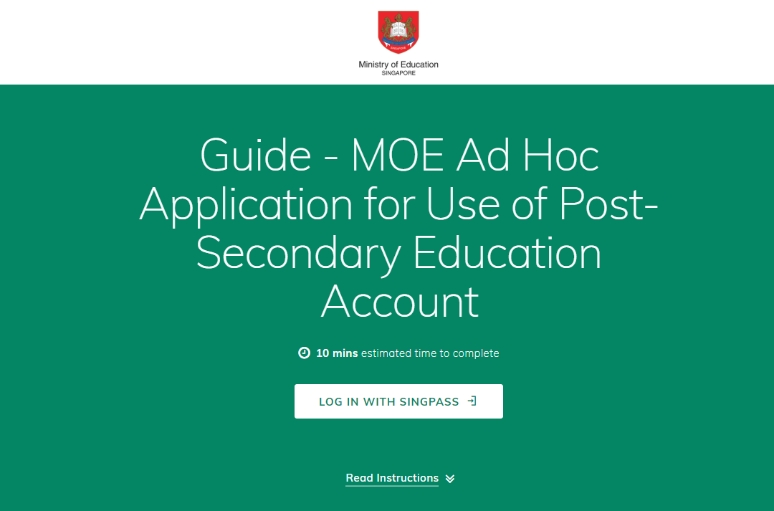
1) Click button to begin.

Slide 3
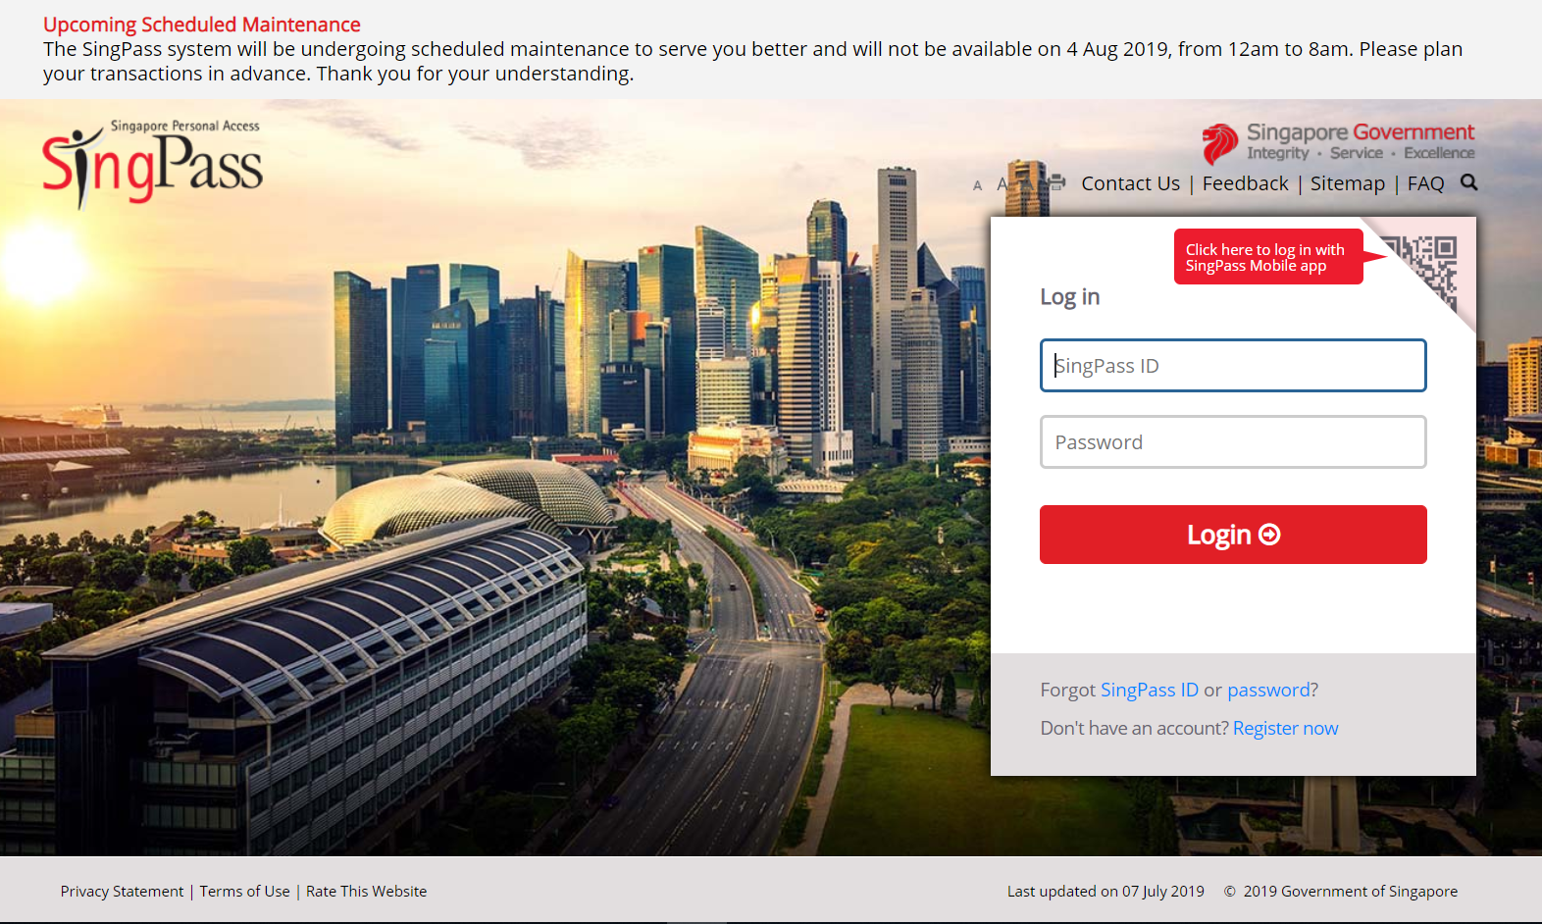
2a) Enter SingPass ID and Password.
2b) Click Login.

Slide 4
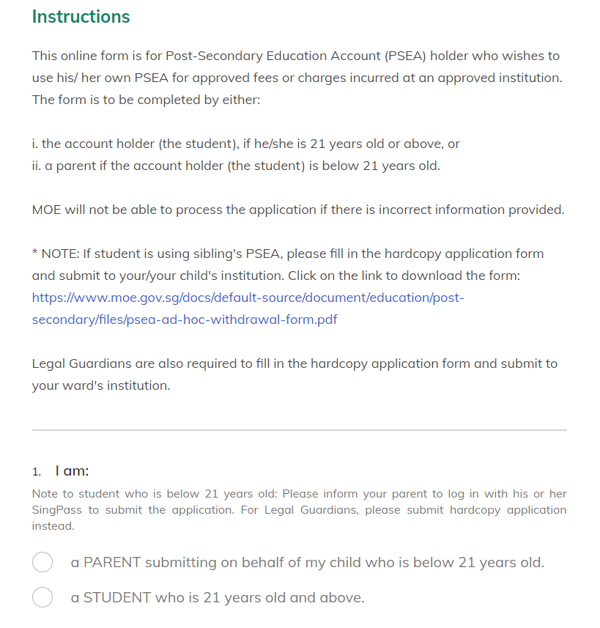
3a) Click one of the options button.

Slide 5
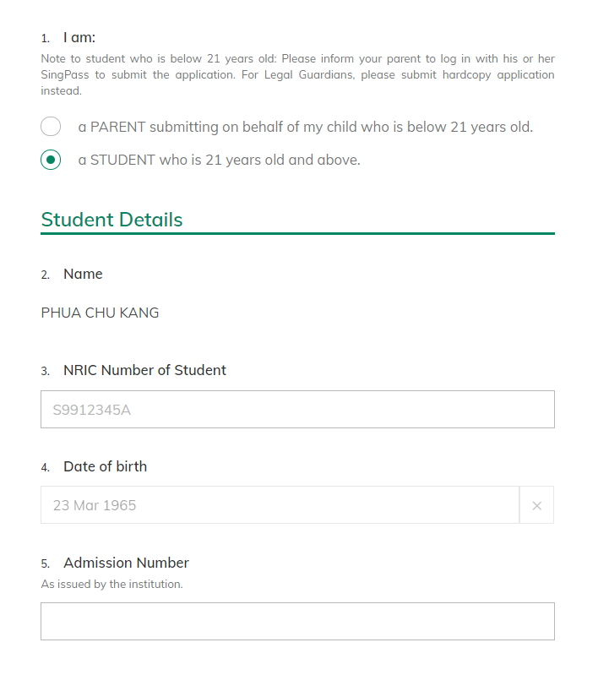
If applicant is the account holder/student
3b) Click “a STUDENT who is 21 years old and above” if you are the account holder and is 21 years old and above.
YOUR NAME [AUTO-FILL BASED ON YOUR SINGPASS LOGIN]
4) Enter all the fields under Student Details.
(Note that the sub-title of the fields may differ from institution to institution.)

Slide 6
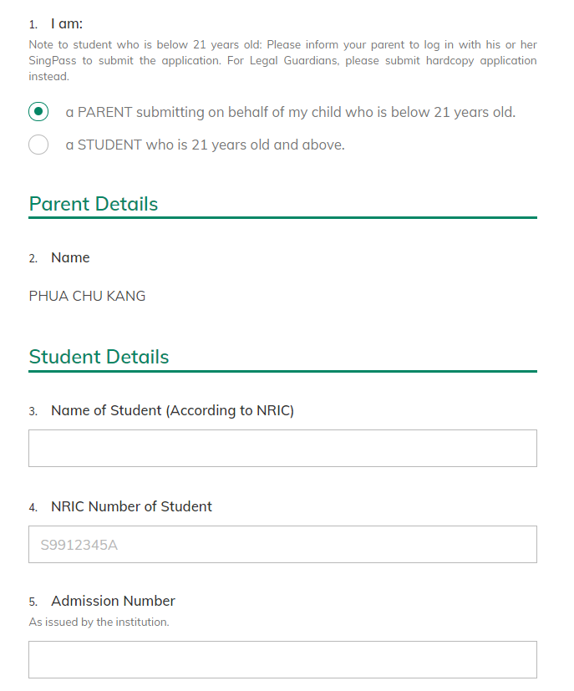
If applicant is the parent of child/account holder
3b) Click “A PARENT submitting on behalf of my child who is below 21 years old” if you are the parent of the account holder/child who is below 21 years old.
NAME OF PARENT [AUTO-FILL BASED ON SINGPASS LOGIN]
4) Enter all the fields under Student Details.
(Note that the sub-title of the fields may differ from institution to institution.)

Slide 7
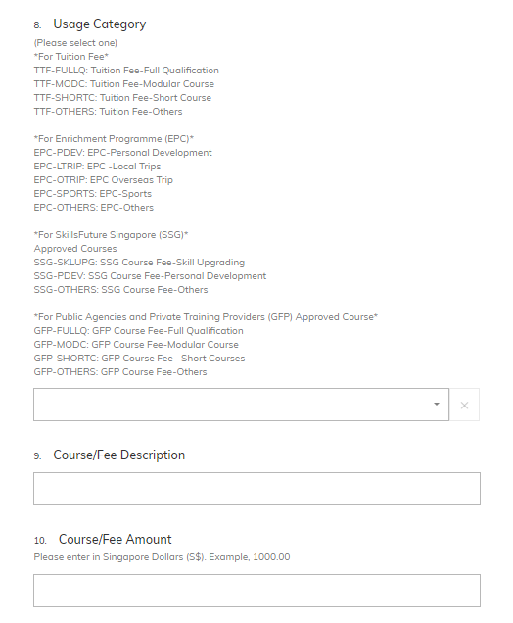
5a) Select on of the Usage Category
(Note that the list of Usage Categories differs from institution to institution)
5b) Please indicate the correct description of the course/fee and the amount.

Slide 8
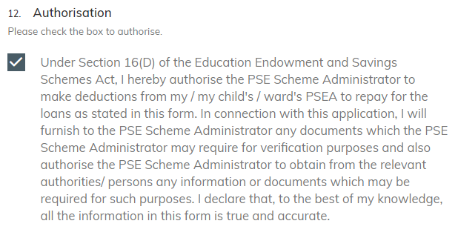
6) Click on the box to authorise PSE Scheme Administrator to make deduction from your / your child’s / your ward’s PSEA to repay for the loan(s).

Slide 9
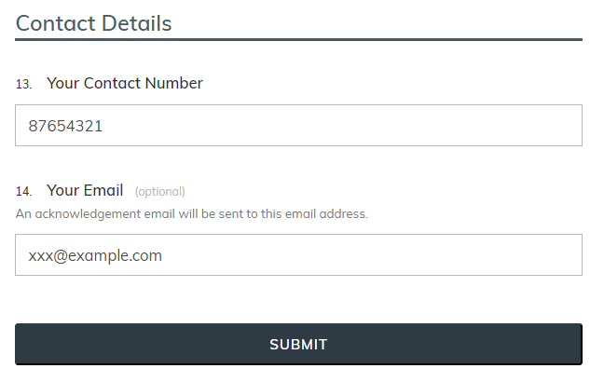
7a) Enter your contact number in case we need to contact you.
7a) (Optional) Enter your email address if you wish to receive an acknowledgement email upon submitting the form.
7c) Click “Submit” once done.

Slide 10
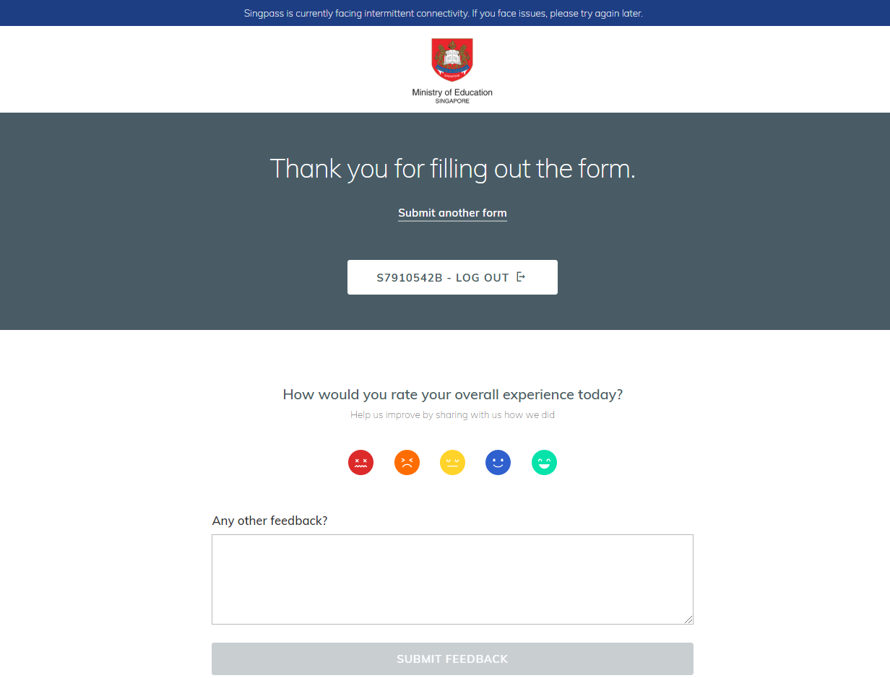
8) Click “LOG OUT” to exit the form.

